Slide 1
Predicting West-Nile in Chicago
Carlton Mezetin, Neil Liberman, Nathan Hall

Slide 2
West Nile Virus
First US detection 1999 in a set of birds
Most commonly spread mosquitoes
Major Reporting Issues
720 vs 54000
Most cases go undiagnosed
Mild cases are often detected in blood donations
No Vaccine
Mosquito prevention

Slide 3
Why Chicago?
Chicago Population
-2.7 million residents
West Nile in Chicago
2001 first case
2002 First Human case
2004 West Nile Surveillance system

Slide 4
Kaggle Competition
- Challenge Overview
- Our Strategy
- Our Assumptions
- How important is climate to mosquitos?
- Can we make this better with more data?
- Are there any problems between the test and train data sets?
- So what did we find?
- Can’t we just weight the future if we know it?
- How to solve the REAL problem.
- How well did that work?
- Where to go next?
The kaggle competition called us to predict where and when West Nile would be present in Chicago
They provided us with Trap data
Each entry represents a mosquito species from a trap.
Species
Trap #
Location information
If West Nile was present
Etc.

Slide 5
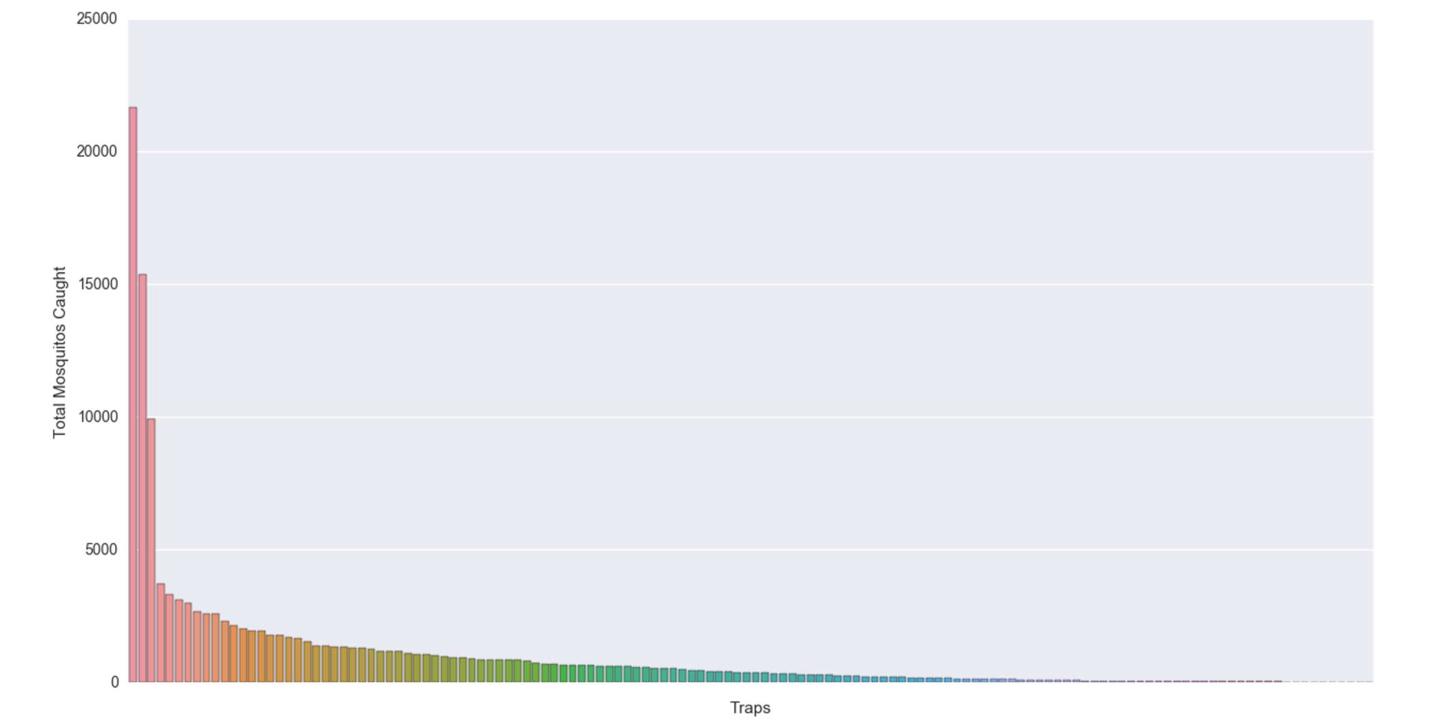
What This Tells Us About Controlling West Nile...
- Challenge Overview
- Our Strategy
- Our Assumptions
- How important is climate to mosquitos?
- Can we make this better with more data?
- Are there any problems between the test and train data sets?
- So what did we find?
- Can’t we just weight the future if we know it?
- How to solve the REAL problem.
- How well did that work?
- Where to go next?

Slide 6
Our Strategy
- Challenge Overview
- Our Strategy
- Our Assumptions
- How important is climate to mosquitos?
- Can we make this better with more data?
- Are there any problems between the test and train data sets?
- So what did we find?
- Can’t we just weight the future if we know it?
- How to solve the REAL problem.
- How well did that work?
- Where to go next?
West Nile Virus is highly correlated with mosquito density, therefore, we sought to find variables associated with a thriving mosquito population.
Much time was therefore spent familiarizing ourselves with the climate factors affecting mosquito populations as well as the behavior of mosquitoes.
Having zeroed in on potential indicators, we accumulated as much relevant data as we could find.

Slide 7
Conducive Conditions for Mosquitoes
Other Factors That May Attract Mosquitoes
- Challenge Overview
- Our Strategy
- Our Assumptions
- How important is climate to mosquitos?
- Can we make this better with more data?
- Are there any problems between the test and train data sets?
- So what did we find?
- Can’t we just weight the future if we know it?
- How to solve the REAL problem.
- How well did that work?
- Where to go next?
Standing Water
High Temperatures
High Humidity
Carbon Dioxide
Lactic Acid
Movement
Grassy Areas

Slide 8
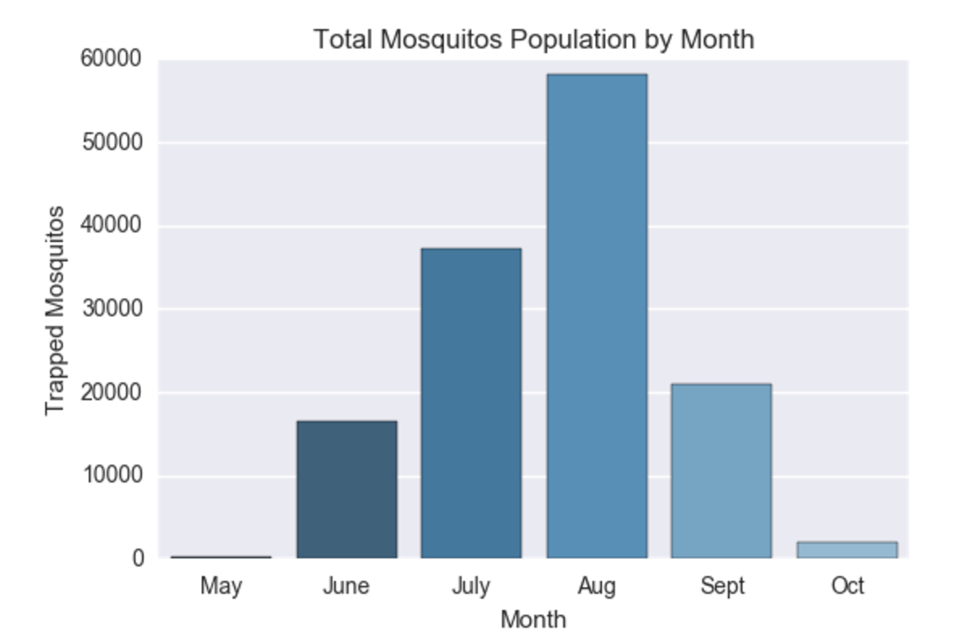
Data Supporting Climate Conditions
- Challenge Overview
- Our Strategy
- Our Assumptions
- How important is climate to mosquitos?
- Can we make this better with more data?
- Are there any problems between the test and train data sets?
- So what did we find?
- Can’t we just weight the future if we know it?
- How to solve the REAL problem.
- How well did that work?
- Where to go next?
Notes:
This graph should help illustrate the correlation between high temperatures and high humidity to thriving mosquito populations.
It also helps clue us into the ideal times to spray.

Slide 9
Finding More Data
- Challenge Overview
- Our Strategy
- Our Assumptions
- How important is climate to mosquitos?
- Can we make this better with more data?
- Are there any problems between the test and train data sets?
- So what did we find?
- Can’t we just weight the future if we know it?
- How to solve the REAL problem.
- How well did that work?
- Where to go next?
We now had an idea of what factors could signal a high mosquito population. What data was available?
Weather:
Temperature
Dew Point
Humidity
Pressure
Wind
Precipitation

Slide 10
Finding Data (continued)
- Challenge Overview
- Our Strategy
- Our Assumptions
- How important is climate to mosquitos?
- Can we make this better with more data?
- Are there any problems between the test and train data sets?
- So what did we find?
- Can’t we just weight the future if we know it?
- How to solve the REAL problem.
- How well did that work?
- Where to go next?
Public Parks
Mountain Bike Trails
Bodies of water (> 0.001 sq. miles)
Local Farms
CO2 Building Emissions

Slide 11
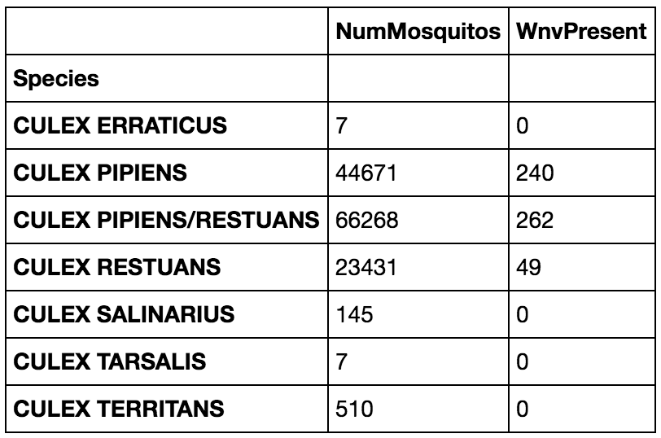
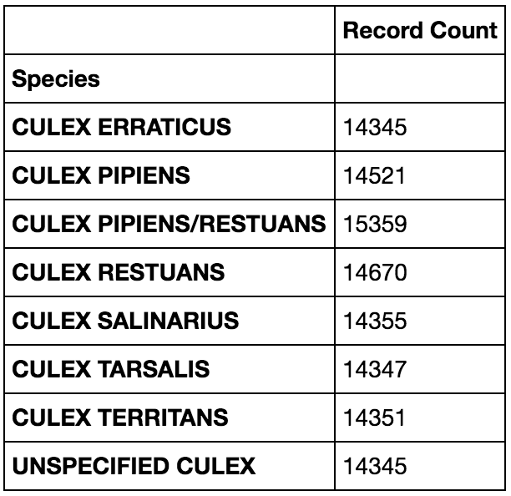
One big problem...
- Challenge Overview
- Our Strategy
- Our Assumptions
- How important is climate to mosquitos?
- Can we make this better with more data?
- Are there any problems between the test and train data sets?
- So what did we find?
- Can’t we just weight the future if we know it?
- How to solve the REAL problem.
- How well did that work?
- Where to go next?
Train Data Set
Test Data Set
Notes:
Unbalanced classes between the two sets.
This means we have no west-nile positive counts for some species.
We also have 14,000 records of Unspecified mosquitos in the test set that DO NOT exist in the training data set.

Slide 12
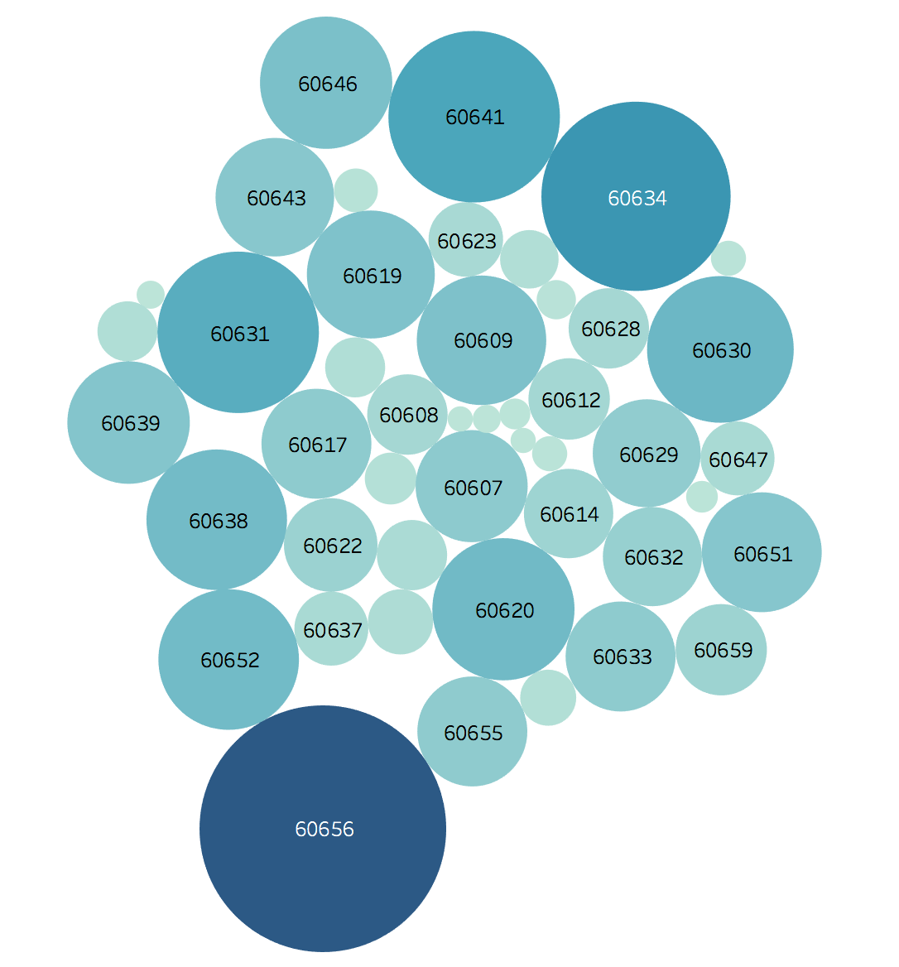
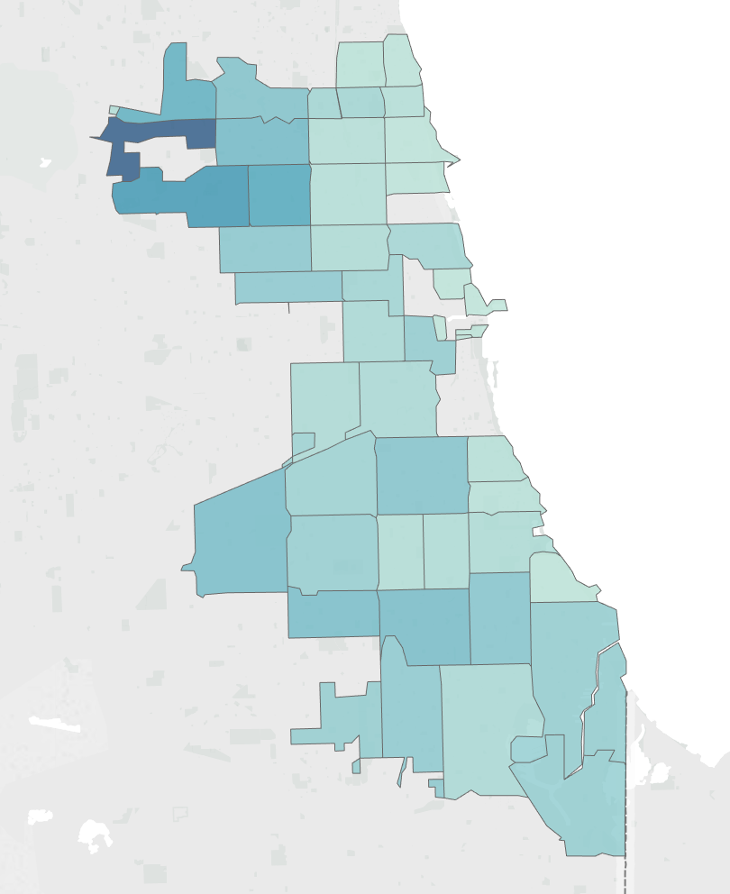
Visualizing our Target Spray Locations
- Challenge Overview
- Our Strategy
- Our Assumptions
- How important is climate to mosquitos?
- Can we make this better with more data?
- Are there any problems between the test and train data sets?
- So what did we find?
- Can’t we just weight the future if we know it?
- How to solve the REAL problem.
- How well did that work?
- Where to go next?

Slide 13
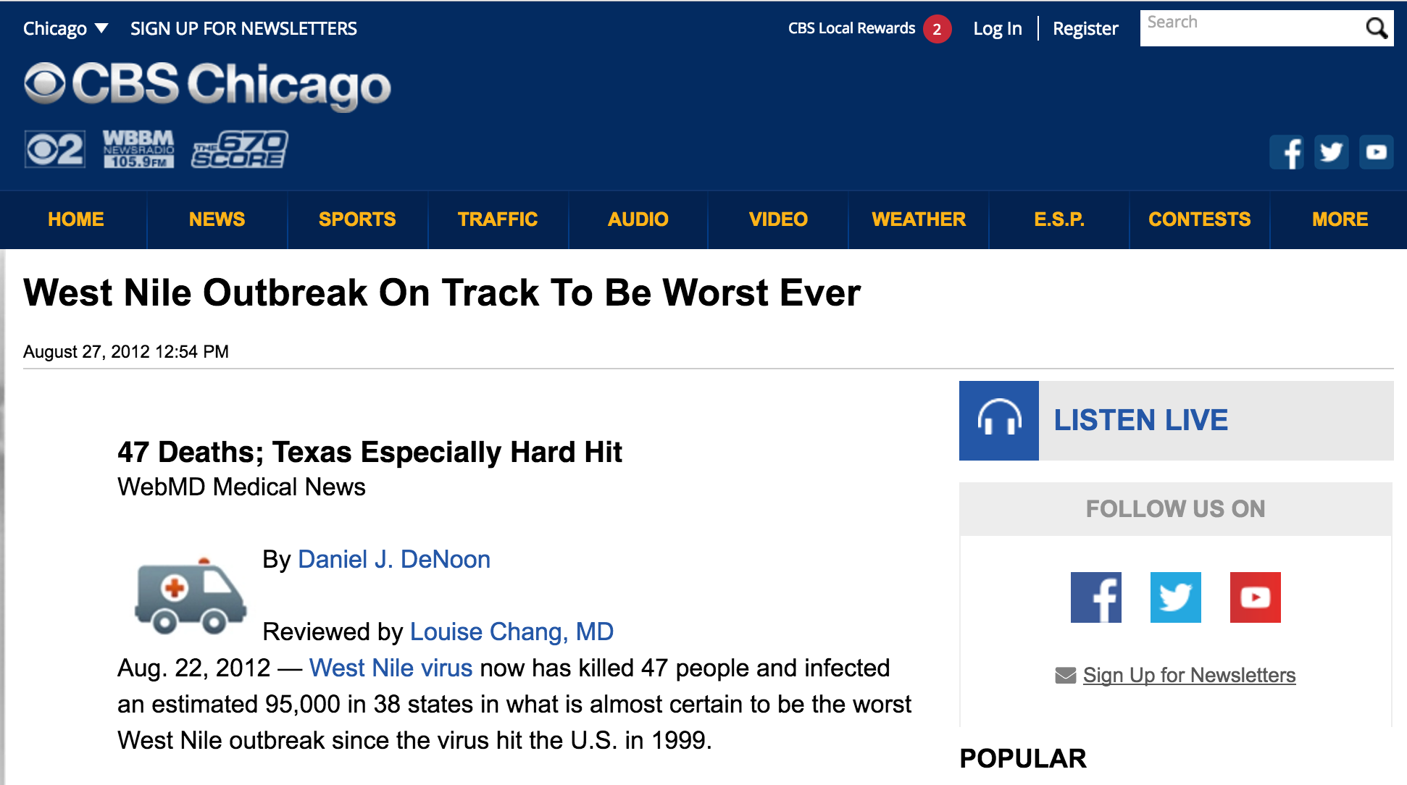
Well wouldn’t that be nice.
- Challenge Overview
- Our Strategy
- Our Assumptions
- How important is climate to mosquitos?
- Can we make this better with more data?
- Are there any problems between the test and train data sets?
- So what did we find?
- Can’t we just weight the future if we know it?
- How to solve the REAL problem.
- How well did that work?
- Where to go next?
Our train set has the year 2012 which simple googling revealed...

Slide 14
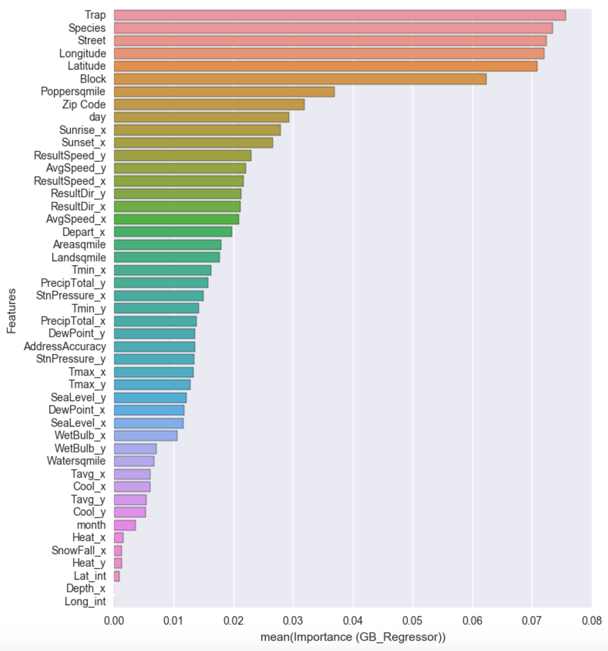
Predicting Mosquito Population
- Challenge Overview
- Our Strategy
- Our Assumptions
- How important is climate to mosquitos?
- Can we make this better with more data?
- Are there any problems between the test and train data sets?
- So what did we find?
- Can’t we just weight the future if we know it?
- How to solve the REAL problem.
- How well did that work?
- Where to go next?

Slide 15
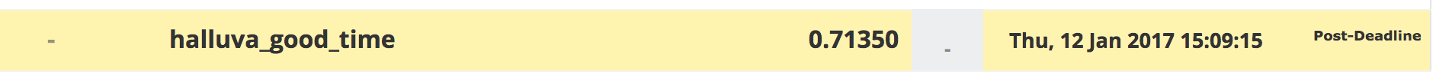
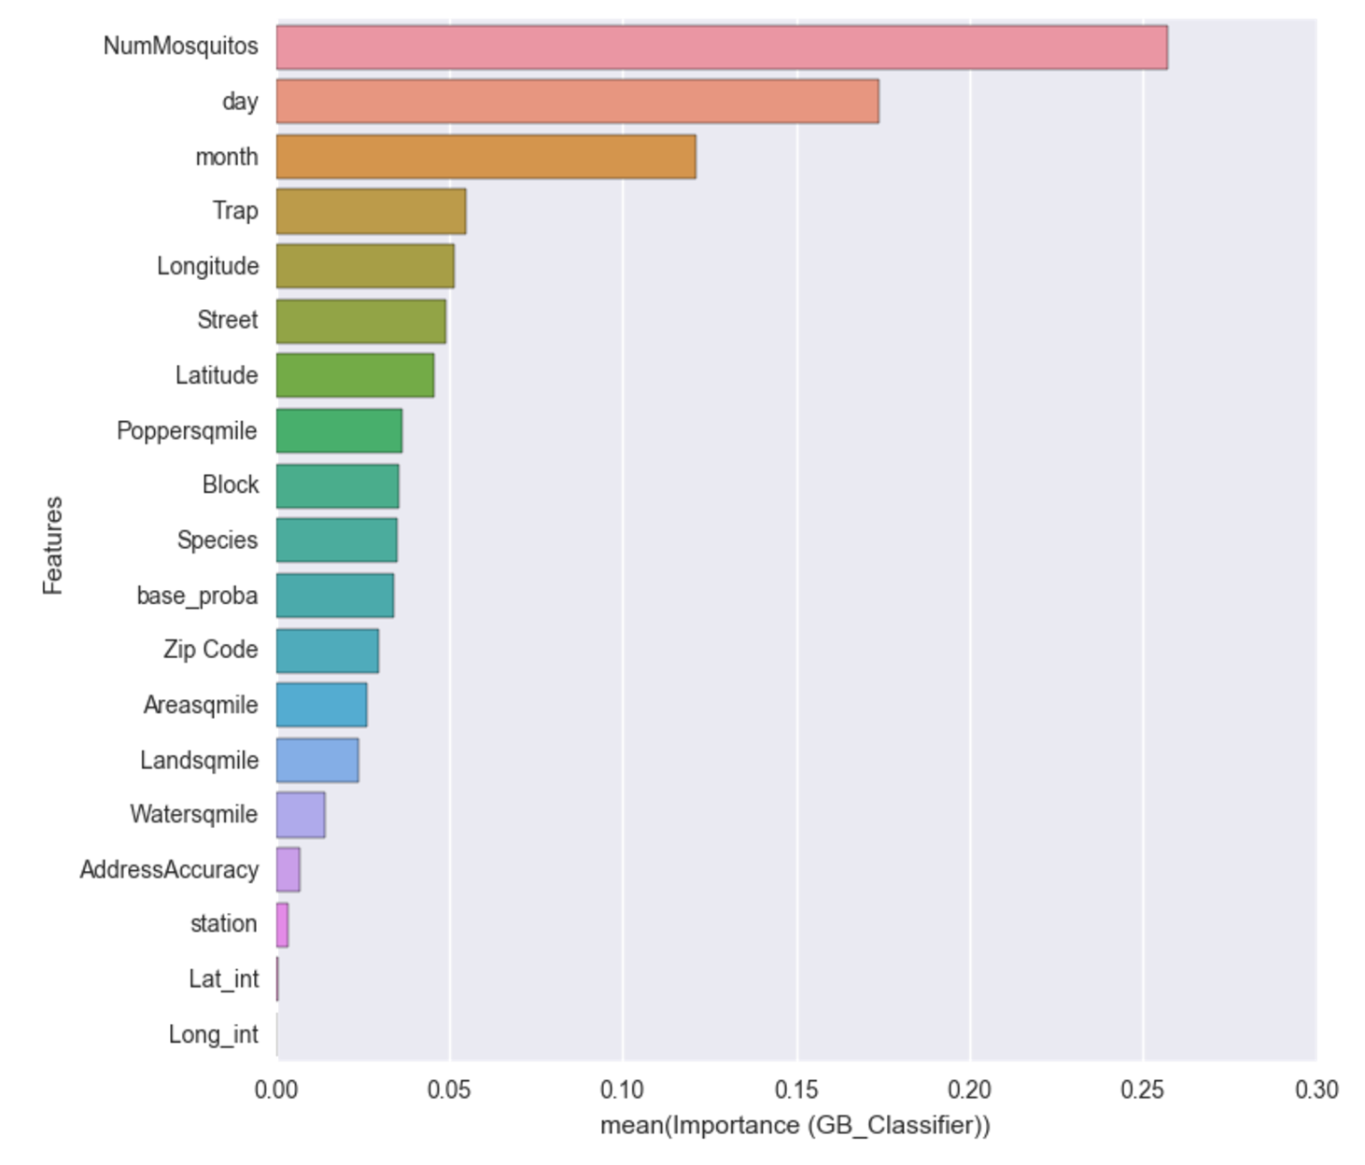
Accuracy on Kaggle
- Challenge Overview
- Our Strategy
- Our Assumptions
- How important is climate to mosquitos?
- Can we make this better with more data?
- Are there any problems between the test and train data sets?
- So what did we find?
- Can’t we just weight the future if we know it?
- How to solve the REAL problem.
- How well did that work?
- Where to go next?

Slide 16
Recommendations.
- Challenge Overview
- Our Strategy
- Our Assumptions
- How important is climate to mosquitos?
- Can we make this better with more data?
- Are there any problems between the test and train data sets?
- So what did we find?
- Can’t we just weight the future if we know it?
- How to solve the REAL problem.
- How well did that work?
- Where to go next?
Improve the predictions of west-nile outbreaks by incorporating west-nile positive case data.
Continue to improve the predictions of mosquito population changes as that has the largest effect on west-nile outbreaks.
Increase spraying during times of favorable breeding weather for mosquitos.

